Slide 1

Driver Drowsiness Detection System For Accident Prevention

Slide 2
Introduction
Driver drowsiness and fatigue is a major factor which results into numerous vehicle accidents.
Developing and maintaining technologies which can efficiently detect or prevent drowsiness at the wheel and alert the driver before am mishap is a major challenge in the field of accident prevention systems.
With the advent of modern technology and real time scanning systems using cameras we can prevent major mishaps on the road by alerting car driver who is feeling drowsy through a drowsiness detection system.

Slide 3
Objectives
Driver drowsiness detection is a car safety technology which spares the life of the driver by avoiding mishaps when the driver is getting drowsy.
• The primary goal is to initially plan a framework to distinguish driver's sluggishness by persistently checking retina of the eye.
• The framework works disregarding driver wearing displays and in different lighting conditions.
• To caution the driver on the identification of laziness by utilizing ringer or alert.
• Speed of the vehicle can be reduced.

Slide 4
Project Requirements
Laptop
Camera
Alarm
Python
OpenCV
Keras

Slide 5
Brief Description-OpenCV
OpenCV is an open source computer vision library accessible in python coding language to code for visionary capabilities of our smart pc.
OpenCV was expected for computational capability and having a high focus on ongoing picture location and distinguishing proof.
Open-CV is coded with streamlined C and can take work with multi-core processors

Slide 6
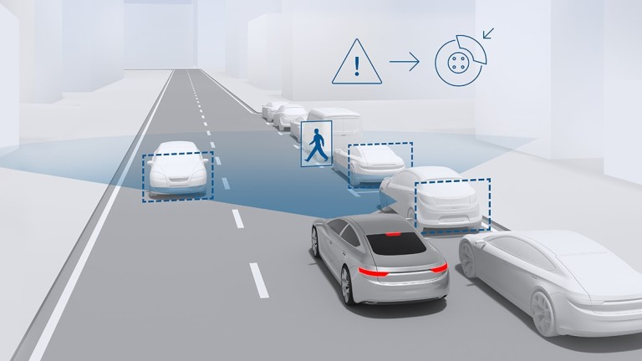
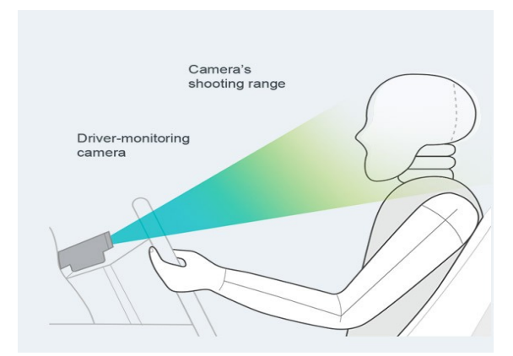
Drowsiness Detection Design
A camera is setup that looks for faces in the input video stream and monitors frames of faces.
In the event that a face is identified, facial milestone identification is connected and the eye district is removed from the edges of the video stream.

Slide 7
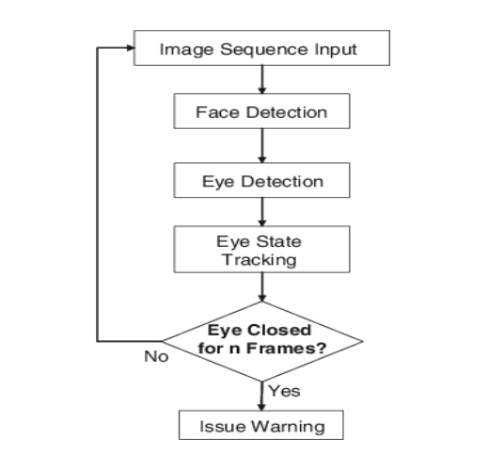
System Architecture of Driver Drowsiness Detection System

Slide 8
Developing Image Processing solutions using OpenCV & Keras
OpenCV was developed keeping image processing in mind.
Every function and data struct of OpenCV concerns itself with an Image Processing library.
Comparatively, Matlab is hugely of generic use & slow.
Any usefulness can be accomplished by methods for tool kits in OpenCV, it might be money related tool compartments or explicit DNA tool stash.

Slide 9
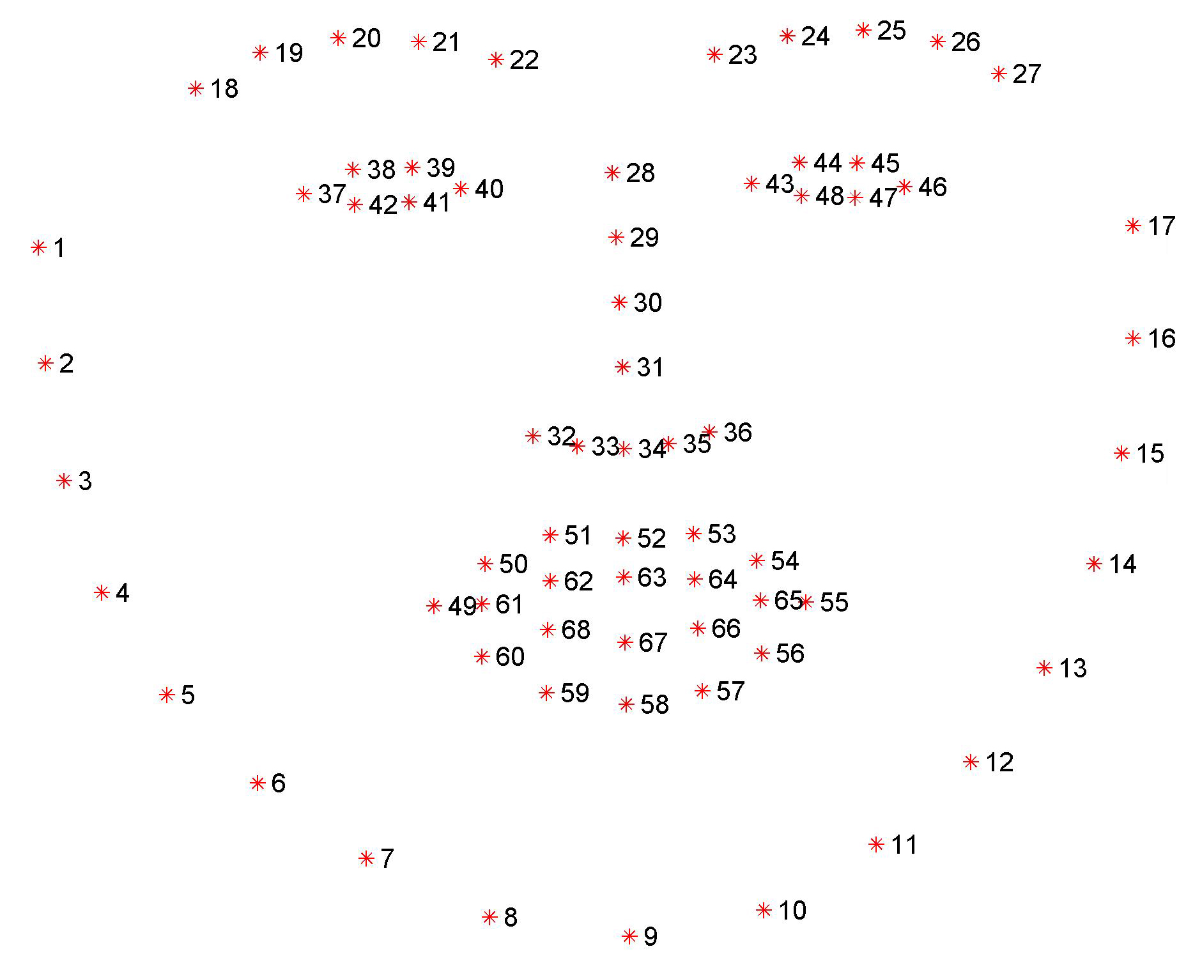
Facial Landmarks using Open-CV

Slide 10
Hindrances
Dependency on proper ambient light.
An optimum range is required.
Orientation of face.
Problem with multiple faces.
Poor detection of a person’s eyes with spectacles.

Slide 11
Futuristic Scopes
This framework can be stretched out further to have abundant security highlights, for example, just a certain no of individuals can have specialist get to or work the vehicle.
If there should be an occurrence of an endeavor to robbery, the vehicle's motor don't begin or an alarm sounds.
A picture of the burglar is taken in an attempted theft & sent to the owner of the vehicle who can register a case against the thief of the vehicle

Slide 12
Conclusion
Thus we would have successfully designed and developed partial implementation of the Driver Drowsiness Detector using Python and OpenCv along with the a cam to detect the face.
The system to be developed is to be tested and limitations are identified.
The rest of the work will be done according to what is planned already.

